Slide 1

Supporting the Support Vector Machines
(SVMs)

Slide 2
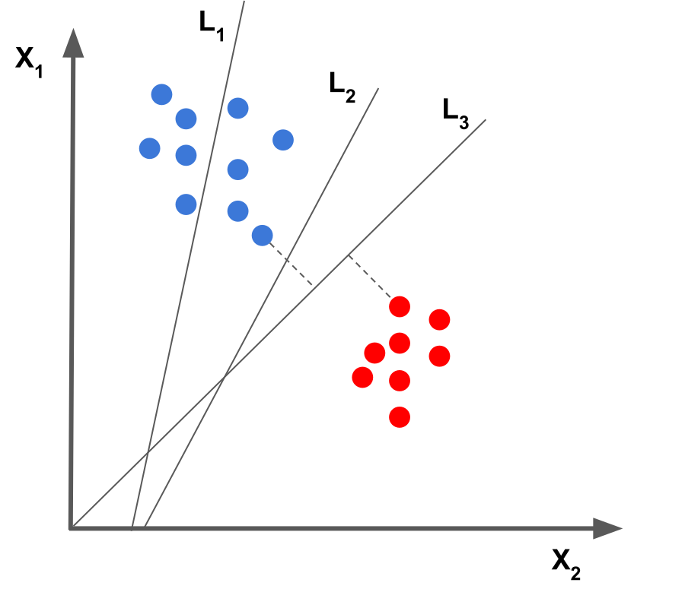
Which Decision Boundary best fits the given data?
Hint: Try to think in terms of patterns and corner points!
Note: Never forget about extending concepts in n-dimensions

Slide 3
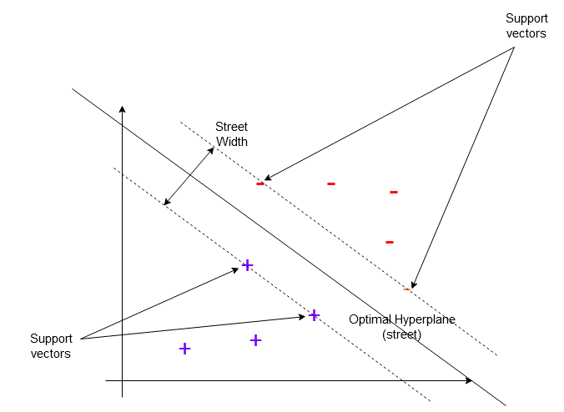
Jargon Alerts !
Street
Street Width
Support Vectors
Hyperplane

Slide 4
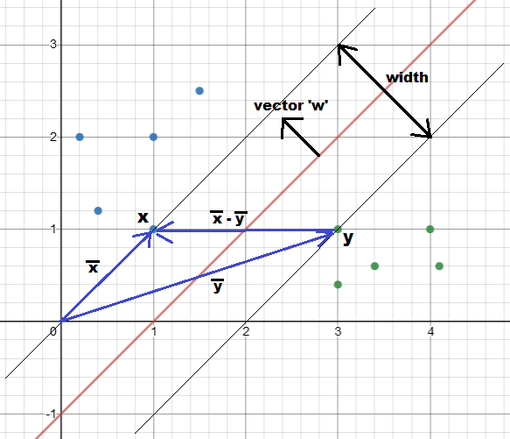
Maths behind SVMs
We try to is maximize the width of the street to find optimum hyperplane
Variables:
w - perpendicular vector to decision boundary
x,y - support vectors of two classes
b - the decision boundary constant.

Slide 5




Easy way to calculate street width
Step 1: Defining Width
Step 3: Separate equations for classes
Step 2: General Support Vector Equation
Step 4: Final Width Expression

Slide 6
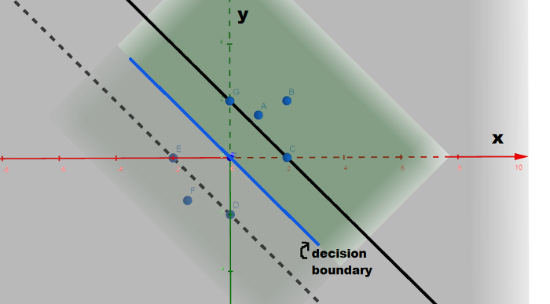
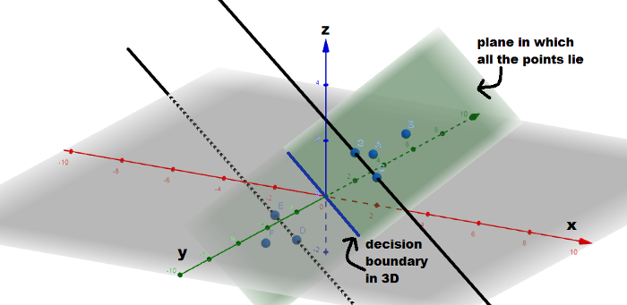
Introducing 3D for better visualization !
The third coordinate ‘z’ is given by
z = w.x + b

Slide 7
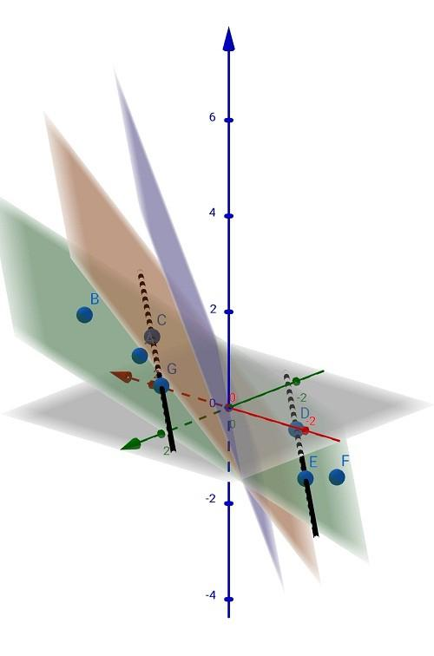

Why ‘1’ only in w.x+b=1?
Since we have selected ‘1’, plane has slope
If we wish to change 1 to any other number, we can but the plane will also rotate along decision boundary

Slide 8






Steps to find Street Width (Method 2)
Step 1
Step 4
Step 2
Step 5
Step 3
Step 6

Slide 9




Minimizing Street Width
(Using Lagrange’s Multipliers)
Step 1: Lagrange’s Multiplier by Definition
Step 3: Equation for ‘w’
Step 4: Differentiating wrt ‘b’
Step 2: Differentiating wrt ‘w’
Step 5: Result of partial differentiation

Slide 10


Minimizing Street Width
(Using Lagrange’s Multipliers)
Step 6: Substituting the values obtained
Step 7: Final expression

Slide 11
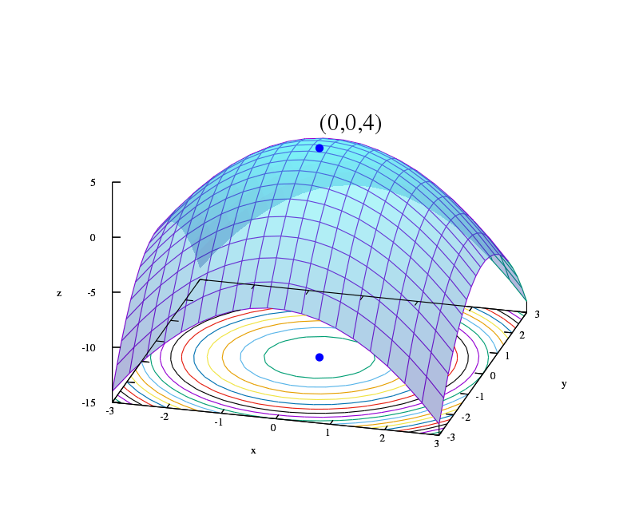
Computation of SVMs Equation
The Equation obtained can be further solved using Quadratic Programming
For more reference: https://en.wikipedia.org/wiki/Quadratic_programming
Why QP?
Hint: The equation for L is quadratic wrt to x and the constraints on x is linear.
Isn’t it a perfect recipe?

Slide 12
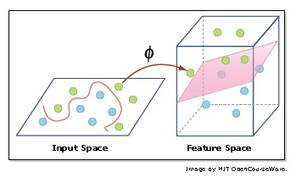

Kernel Trick
Separates non-linear data
Doesn’t actually convert data vectors in higher dimensions, just assumes!
The above computation for dot product using kernel

Slide 13

Gaussian Kernel
Function is given by
Sigma represents similarity between x and y
Similarity
Sigma
General-purpose Kernel

Slide 14
Rock it SVMs !
SVM is usually regarded as an efficient Machine Learning algorithms as it tries to find the best hyperplane
Obviously the above is not true always ! It’s ML, you can’t always be accurate
SVMs can always take n-features meaning the algorithm also works in n-dimension but we can’t demonstrate more than 3 dimensions due to human limitations
The kernel functions can also be used in other Machine Learning Algorithms
You are now beginning to understand SVMs! Thanks

